Slide 1



Introduction to the session
‘Advances in Social Interaction Modelling’
Joaquim Fort
Universitat de Girona (Catalonia, Spain)
SIMEP (Social Interactions in Mediterranean Prehistory)
Barcelona, October 21st, 2024
ICREA Academia Grant 2021 Grant PID2023-150978NB-C22 Grant 2021-SGR-00190

Slide 2
Types of social interactions
Individuals (and populations) interact in many ways:
1. Cultural transmission: spread of innovations, exchange of items, ideas, languages...
2. Conflict and warfare.
3. Mutualism.
4. Diseases.
5. etc.
This session is devoted to modelling social interactions

Slide 3
Types of social interactions
Some examples of these social interactions covered in this session:
·Conflict in Bronze Age Crete,
by Andrea Santamaria et al.
·Cultural transmission:
·The Bell Beaker complex in the western Mediterranean,
by Tom Davy et al.
·The Dualist prehistoric Mediterranean ideology,
by Cédric Bodet.

Slide 4
Demography
Social interactions often affect demography and vice versa. How is demography quantified in prehistory?
One approach: Summed probability distributions (SPDs):
Central
and
Northwest
Europe
Shennan et al., Nature Comm. (2013)

Slide 5
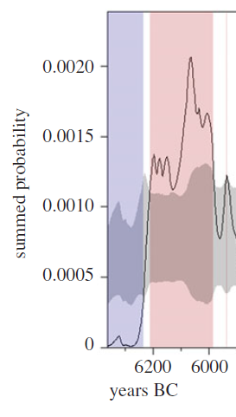
Demography
Over much shorter time intervals
(<100 yr) SPDs have been used
to estimate initial growth rates, which are necessary to model waves of advance
growth rate=2.4%
Ethnographic range=2.1-3.4%
Serbian early
Neolithic
Porcic et al., Phil. Trans. Roy. Soc. (2021)

Slide 6
Demography
Estimations of human population densities inferred from the spatio-temporal distribution of archaeological sites still remain challenging, specially for low-density areas.
Recent approach: The Cologne protocol.
This session includes a talk based on it:
Demographic estimates during the Early Upper Palaeolithic in Iberia,
by Javier Fernández-López de Pablo et al.

Slide 7
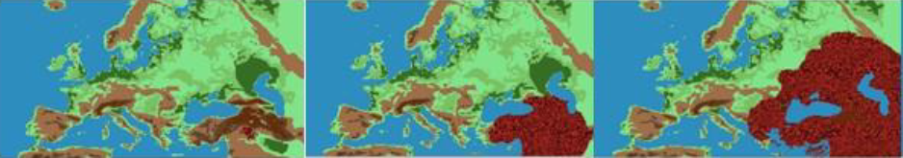

Population diffusion
Population diffusion is often linked to social interactions. Example: Neolithic spread
Barceló & Palacios,
in Moving and Migrating in Prehistoric Europe. Edited by Heyd, V. & Ahola, M. London: Routledge (2023)

Slide 8
Population diffusion

Slide 9
Population diffusion
2 talks on population diffusion in this session:
·Long-term consequences of migration and population movements,
by Joan Barceló.
·The spread of pressure blade making alongside farmers,
by Bogdana Milic et al.

Slide 10


Diffusion and cultural transmission
Cultural transmission leads to a faster spread rate.
3 types:
vertical horizontal oblique
parents
F HG HG HG HG HG F
culture genes genes genes culture
child culture
F F F F

Slide 11
Effect of acculturation intensity C
on the front speed in Europe
Fort, PNAS (2012)
Fort,
Hum. Popul. Gen. & Genom. 2022
EUROPE (0.9-1.3 km/yr)
demic
speeds
($C=0$)
$$C_{max}= 2.5$$

Slide 12
Effect of cultural diffusion in Europe
Effect (%) = (speed – demic speed) /speed · 100
0-48% cultural effect
Fort, PNAS (2012)
Fort,
Hum. Popul. Gen. & Genom. 2022
$${previuos slide → C}_{max}= 2.5$$

Slide 14
J. Fort, The spread of agriculture: general laws in prehistory?
in Simulating transitions to agriculture in prehistory,
eds. S. Pardo-Gordó & S. Bergin (Springer, Cham, 2021), p. 17-28.

Slide 15
Diffusion and cultural transmission
2 talks in this session will deal with the effects of cultural transmission in population diffusion:
·Interbreeding along the coastal and inland routes
of Neolithic spread in Europe,
by Joaquim Pérez-Losada.
·The spread of the Neolithic in the Western Mediterranean,
by Joaquim Fort.

Slide 16
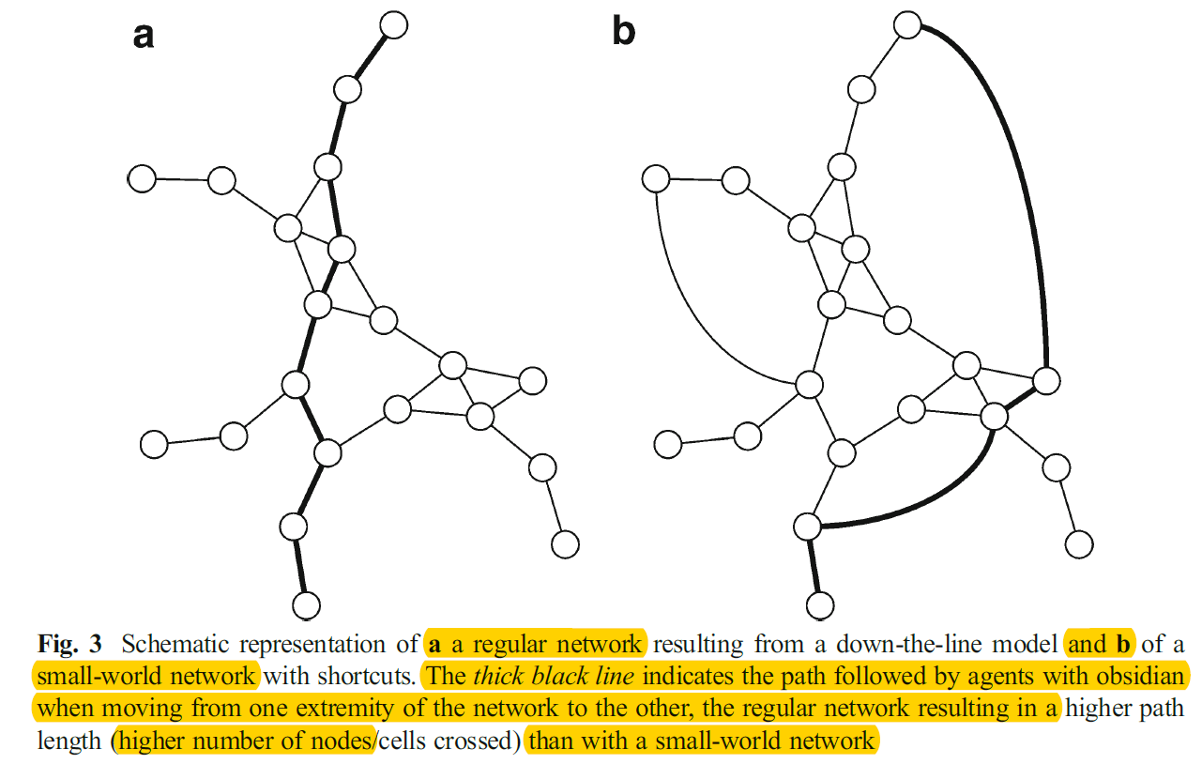
Networks: ordinary diffusion fails
Ortega, Ibáñez, Khalidi, Méndez, Campos & Teira, JAMT (2014)

Slide 17
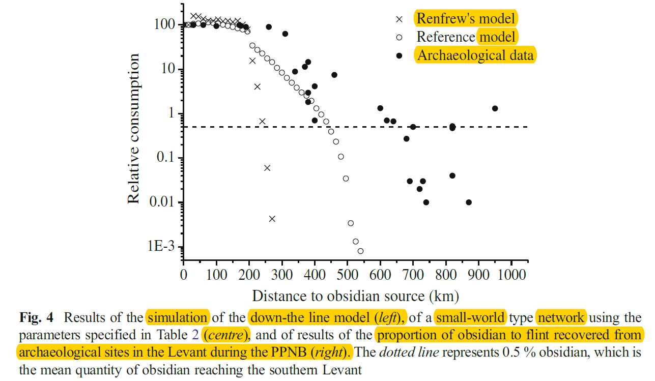
Networks
Modelling obsidian exchange in the Near East
small-world network model
Ortega, Ibáñez, Khalidi, Méndez, Campos & Teira, JAMT (2014)

Slide 18
Networks
This session includes 3 talks on networks:
· Obsidian exchange in the Near East,
by Juan José Ibáñez & Fiona Pichon.
· Ornaments in the Iberian Palaeolithic and Neolithic,
by Albert García-Piquer et al.
· Material culture and biological relatedness in Çatalhöyük,
by Camilla Mazzuccato & Michele Coscia.

Slide 19
Thank-you.
Enjoy the session!

