Slide 1



Interbreeding and demic diffusion
in the spread of the Neolithic
in Europe
Joaquim Fort
Universitat de Girona (Catalonia, Spain)
World Neolithic Congress
Sanliurfa (Turkey), Nov. 5th 2024
ICREA Academia Grant 2021 Grant PID2023-150978NB-C22 Grant 2021-SGR-00190

Slide 2
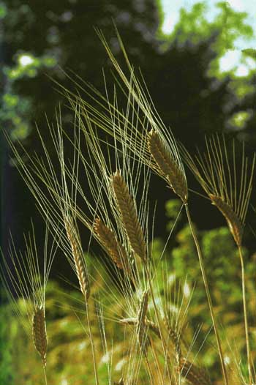
Models of Neolithic spread
Demic diffusion = Farming populations spread = dispersal + net reproduction.
Cultural diffusion = spread of ideas = transmission of plants, animals and knowledge from farmers to hunter-gatherers = = cultural transmission.
Demic-cultural models

Slide 3
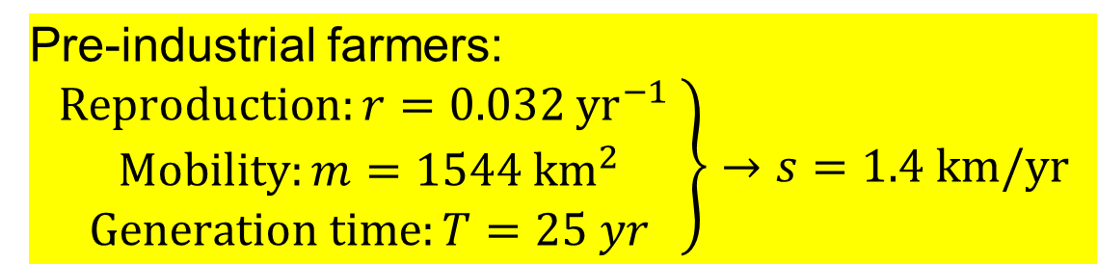
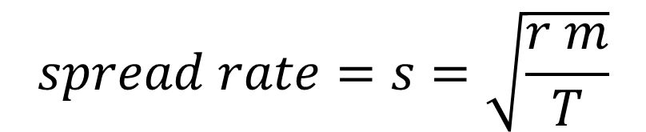
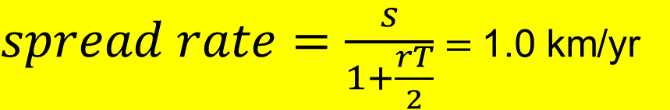
Demic models
1) Wave of Advance demic model
$$spread rate=s=\sqrt{\frac{r m}{T}}$$
Pre-industrial farmers:
$$\left.\begin{matrix}Reproduction:r=0.032 {yr}^{−1} \\ Mobility:m=1544 {km}^{2} \\ Generation time:T=25 yr\end{matrix}\right\}→s=1.4 km/yr$$
Ammerman & Cavalli-Sforza (1973)
2) Time-delayed demic model
$spread rate=\frac{s}{1+\frac{rT}{2}}$ $=$1.0 km/yr
Fort & Méndez (1999)

Slide 4
Archaeological data
Ammerman & Cavalli-Sforza (1971, 1984)
53 sites in Europe
r = 0.89 (Jericho, highest-r origin)

Slide 5
Why did Ammerman & Cavalli-Sforza suggest a mainly demic process?
Because demic models agrees
with the archaeological data:
Demic model  1 km/yr
Archaeological data*  1 km/yr
*Other databases also yield about 1 km/yr:
·Gkiasta, Russell, Shennan & Steele (2003): 510 sites
·Pinhasi, Fort & Ammerman (2005): 735 sites
·Baggaley, Sarson, Shukurov et al. (2012): 302 sites
·Bocquet-Appel et al. (2012): 940 sites
·Fort, Pujol & vander Linden (2012): 919 sites
·etc.

Slide 6
Today there is no doubt that
Ammerman & Cavalli-Sforza were right
Ancient genome-wide studies have shown that >90% of the genomic ancestry of early European farmers is due to a population source in Anatolia (Mathieson et al., Nature 2015).
This confirms that it was mainly demic.
But such studies have not answered some key questions:
1. Mean distance moved by early farmers?
2. Did it depend on the route (inland/coast)?
3.% of early farmers that interbred with HGs?
4.Did it depend on the route (inland/coast)?
In this talk we will deal with these questions.

Slide 7
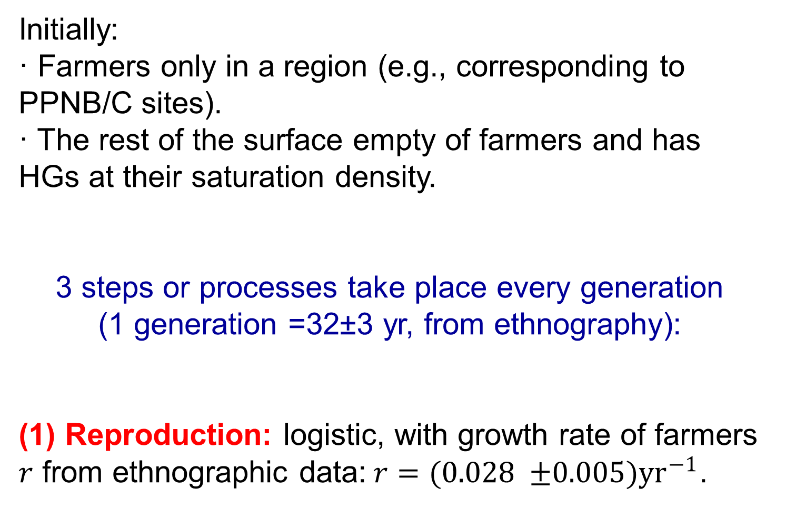
Demic-cultural model
Initially:
· Farmers only in a region (e.g., corresponding to PPNB/C sites).
· The rest of the surface empty of farmers and has HGs at their saturation density.
3 steps or processes take place every generation
(1 generation =32±3 yr, from ethnography):
(1) Reproduction: logistic, with growth rate of farmers $r$ from ethnographic data:$r=(0.028 {±0.005)yr}^{−1}$.

Slide 8
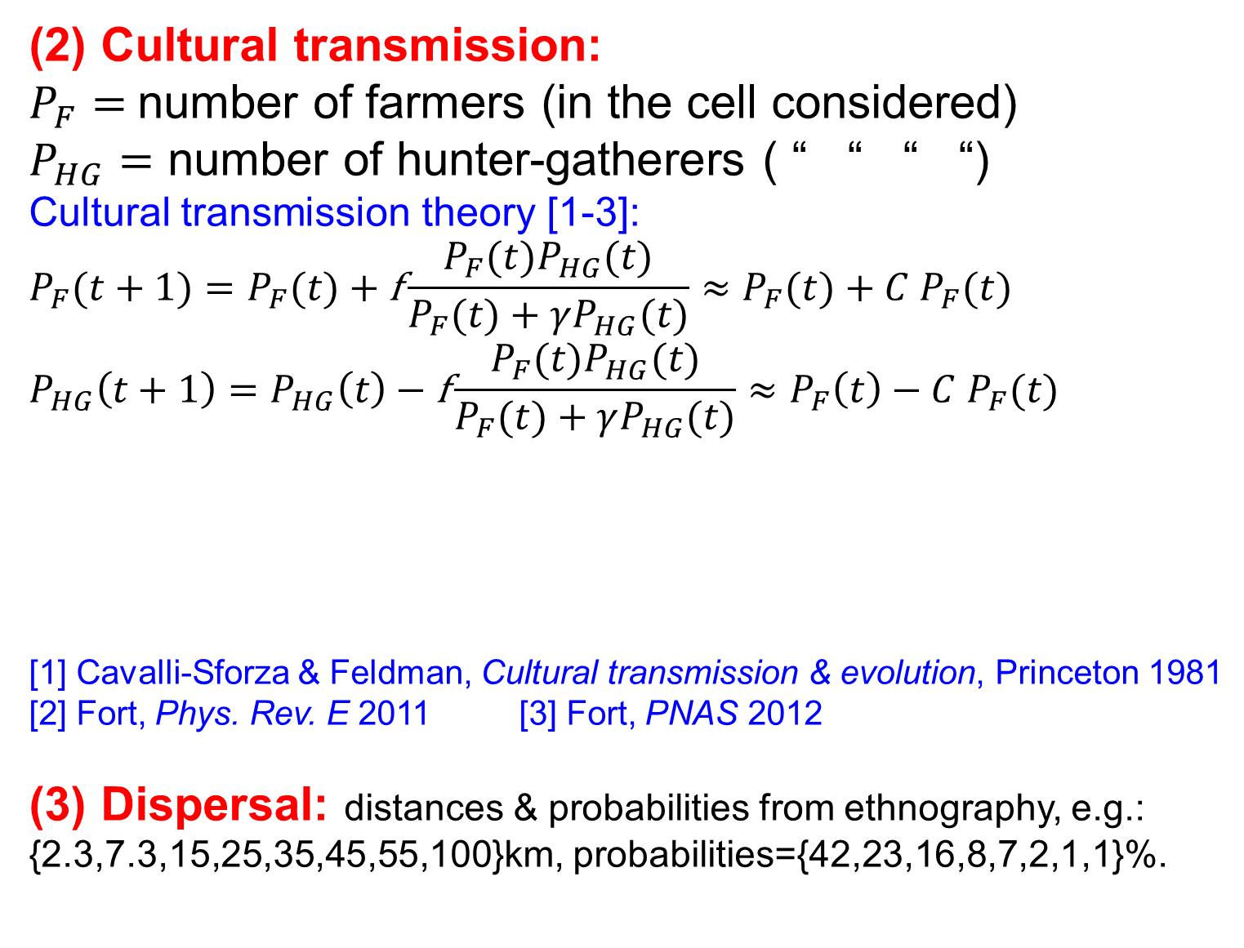
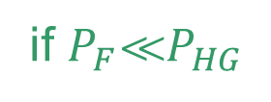
(2) Cultural transmission:
$P_{F}=$number of farmers (in the cell considered)
$P_{HG}=$ number of hunter-gatherers ( “ “ “ “)
Cultural transmission theory [1-3]:
$$P_{F}(t+1)=P_{F}(t) \text{+} \text{f}\frac{P_{F}(t)P_{HG}(t)}{P_{F}(t)+γP_{HG}(t)}≈P_{F}(t)\text{ +} {C P}_{F}(t)$$
$$P_{HG}\left(t+1\right)=P_{HG}\left(t\right)−\text{f}\frac{P_{F}(t)P_{HG}(t)}{P_{F}(t)+γP_{HG}(t)}≈P_{F}\left(t\right)−{C P}_{F}(t)$$
[1] Cavalli-Sforza & Feldman, Cultural transmission & evolution, Princeton 1981
[2] Fort, Phys. Rev. E 2011 [3] Fort, PNAS 2012
(3) Dispersal: distances & probabilities from ethnography, e.g.:
{2.3,7.3,15,25,35,45,55,100}km, probabilities={42,23,16,8,7,2,1,1}%.
if $P_{F}P_{HG}$

Slide 9
To apply this model we need a range for the spread rate from archaeological data
0.9-1.3 km/yr
great circles & shortest paths
r = 0.83
(for both highest-r origins)
735 sites in Europe & Near East
Pinhasi, Fort & Ammerman,
PLoS Biol. (2005)

Slide 10
Effect of the intensity of cultural transmission C
on the spread rate
Fort, PNAS (2012)
demic
speeds
($C=0$)
$$C_{max}= 2.5$$

Slide 11
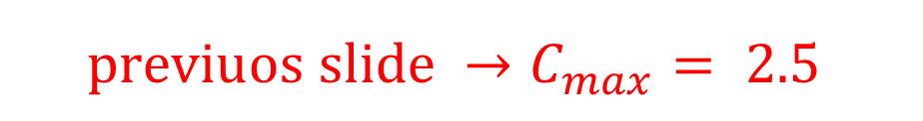
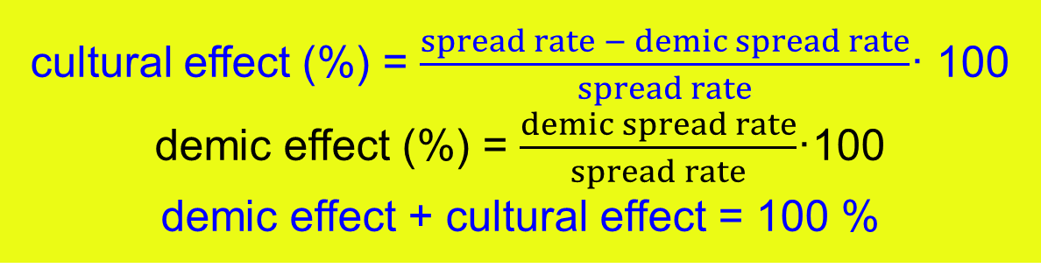
cultural effect (%) = $\frac{spread rate − demic spread rate}{spread rate}$· 100
demic effect (%) = $\frac{demic spread rate}{spread rate}$·100
demic effect + cultural effect = 100 %
0-48% cultural effect
52%-100%
demic
effect
$${previuos slide →C}_{max}= 2.5$$
Fort, PNAS (2012)

Slide 12
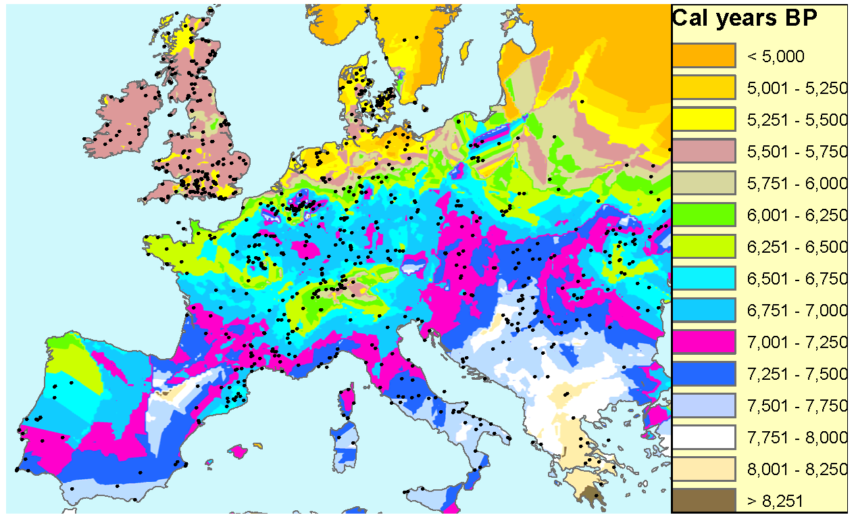
Two routes
inland
route
sea route
Fort, J. R. Soc. Interface (2015)

Slide 13


Simulations + archaeological data
Initially there are farmers only at the cell with the oldest PPNB site in Upper Mesopotamia (Abu Hureyra, <9,038 cal BC) at a date (8,718 cal BC) such that the simulations agree with the data along the inland route.
Inland route: simulations with jumps of 50 km per generation (value from ethnography)
0 1000 2000 3000 4000 5000 6000 7000
b
140
4500
120
E
D
I
5000
Sea route: best fit for simulations with jumps of 70 km per generation
100
H
J
5500
time (generations)
inland route
C
G
time (cal yr BCE)
80
6000
(jumps of 50 km)
0.9 km/yr
SIMULATIONS
sea route (jumps of 70 km)
A northern Mesopotamia
B Anatolia
C Germany
D northern France
E Belgium
F Cyprus
G Southern France
H Catalonia
I Navarre
J central Portugal
6500
60
7000
40
7500
20
B
1.6 km/yr
8000
F
8500
0
A
0
1000 2000 3000 4000 5000 6000 7000
Distance to Abu Hureyra (km)
Fort & Pérez-Losada, Nature Comm. 2024

Slide 14
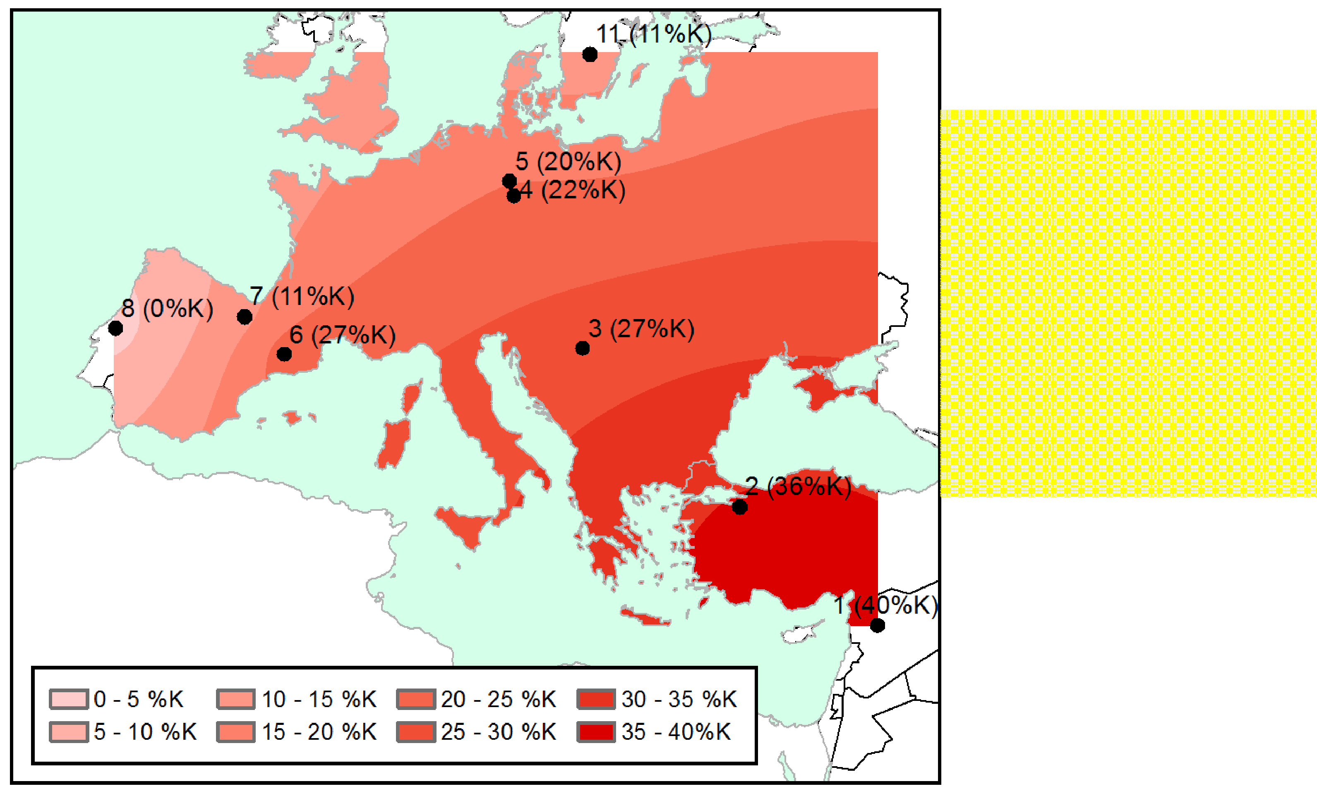
Ancient genetics
mtDNA haplogroup K is the most frequent one in early farmers. It is essentially absent in HGs
This pattern in
early farmers suggests interbreeding with HGs
Isern,Fort & de Rioja,
Sci. Rep. (2017)
Now we have data for more regions and can analyze both routes separately

Slide 15
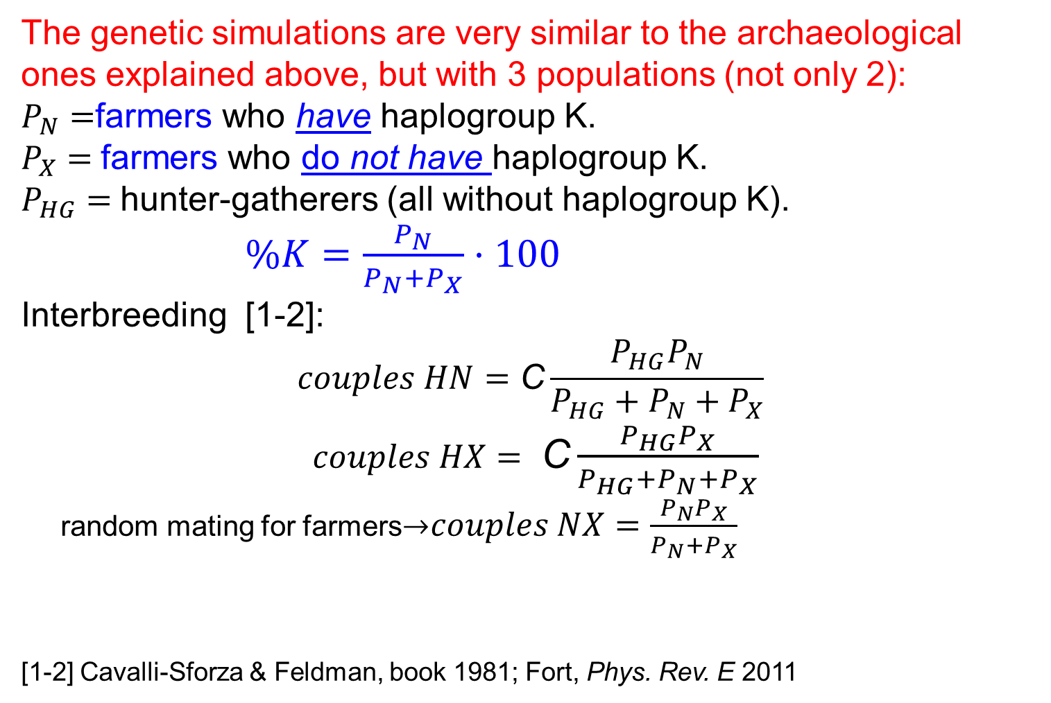
Simulations
The genetic simulations are very similar to the archaeological ones explained above, but with 3 populations (not only 2):
$P_{N}=$farmers who have haplogroup K.
$P_{X}=$farmers who do not have haplogroup K.
$P_{HG}=$hunter-gatherers (all without haplogroup K).
$\%K=\frac{P_{N}}{P_{N}+P_{X}}·100$
Interbreeding [1-2]:
$$couples HN=\text{C}\frac{P_{HG}P_{N}}{P_{HG}+P_{N}+P_{X}}$$
$couples HX=$ $\text{C}\frac{P_{HG}P_{X}}{P_{HG}+P_{N}+P_{X}}$
random mating for farmers$couples NX=\frac{P_{N}P_{X}}{P_{N}+P_{X}}$
[1-2] Cavalli-Sforza & Feldman, book 1981; Fort, Phys. Rev. E 2011

Slide 16
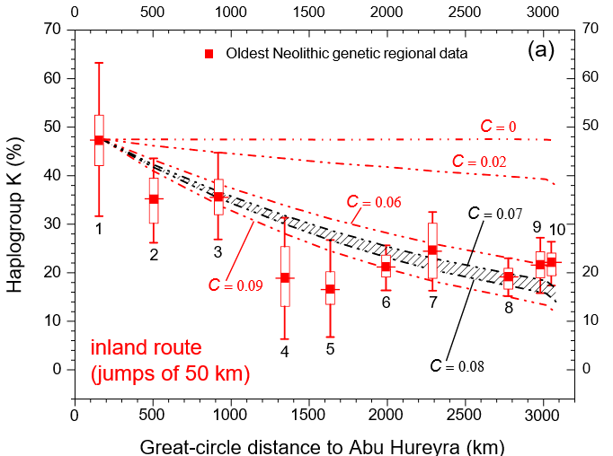
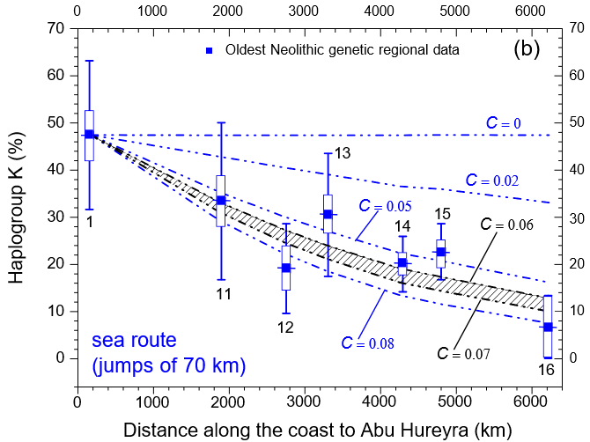
Sea route
Inland route
Best fits: C = 0.07-0.08 Best fits: C = 0.06-0.07
Essentially the same!
Fort & Pérez-Losada, Nature Comm. 2024

Slide 17
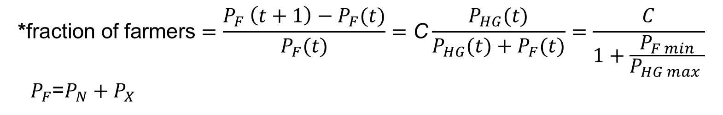
·Previous slide: C ≈ 0. 07 , so about
3.6% * of early farmers interbred with a HG.
·Taking into account the uncertainties in the parameter values (r, p_{F max}, p_{HG max}, p_{F min}) and in the initial frequencies of haplogroup K: 0. 03 < C < 0. 14 , so
1% - 8% * of early farmers interbred with a HG.
Genetics → 0. 03 < C < 0. 14
$$\text{∗}\text{fraction} \text{of} \text{farmers}=\frac{P_{F} \left(t+1\right)−P_{F}(t)}{P_{F}(t)}=\text{C}\frac{P_{HG}(t)}{P_{HG}(t)+P_{F}(t)}=\frac{C}{1+\frac{P_{F min}}{P_{HG max} }}$$
$P_{F}$=$P_{N}+P_{X}$

Slide 18
We can obtain independent estimations from archaeological and genetic data

Slide 19
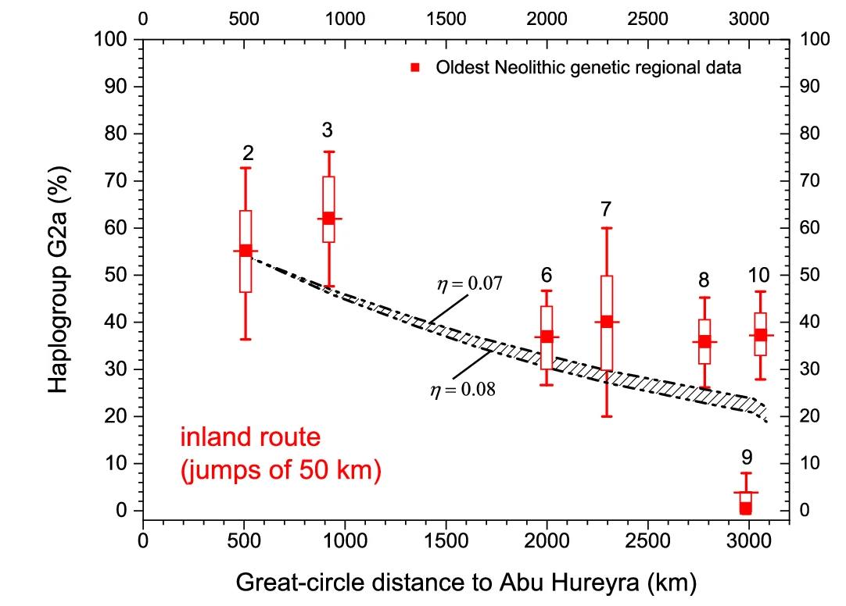
Y chromosome
Haplogroup G2 is the most frequent one in farmers. It is essentially absent in hunter-gatherers
We obtain again C ≈ 0.07,
in agreement with the mt DNA results
C
C
Fort &
Pérez-Losada,
Nature Comm.
2024
For the sea route there are not enough data
19

Slide 20
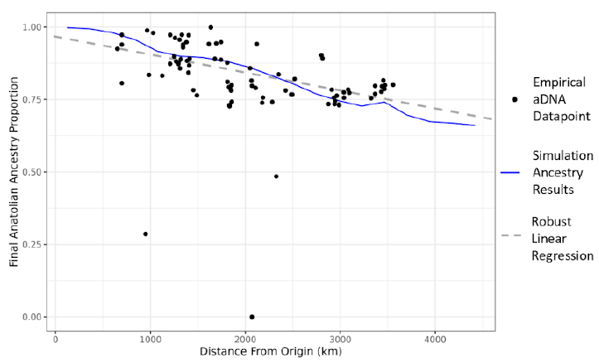
Whole genome
LaPolice,
Williams
& Huber,
bioRxiv (2024)
They obtain that about 0.1% of early farmers interbred with a HG or acculturated him/her each year, i.e. about 0.1% ·32 yr = 3.2% per generation.
This is consistent with our estimation (previous slides) that 1% - 8% * of early farmers interbred with a HG or acculturated him/her.

Slide 21
Conclusions
Archaeology tells us that:
Concerning dispersal, geography had a very important effect: early farmers moved longer distances per generation along the sea route than inland.
In sharp contrast to this, ancient genetics tells us that:
The interbreeding percentage of farmers was essentially the same along both routes. It did not depend on geography but only on the transition in the subsistence economy and its way of life.
Archaeology and genetics agree on the importance of cultural diffusion: 2%-24%

